Slide 1
2023 winter School
Moose Jaw, SK
Jan 29, 30, 31, Feb 1
Jason Schrader, Aaron Vopni, Wayne Harriman, Scott Yaskowich, Andrew Ngo, Ryan Bagsik

Slide 2
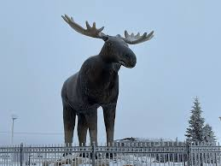
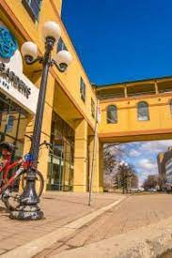
2023 Winter School

Slide 3
2023 Winter School
This was a 4 day education that 6 members of 3730 attended. All 6 members were engaged and involved in the courses. There were several different courses and we had a member enrolled in each at this particular school. Thanks to all that were involved in making this a member building experience from our local and with the rest of Saskatchewan.

