Slide 1
CUPE SASKETCHEWAN
Convention 2022/23
March 8, 9, 10
Delta Hotel Regina
Jason Schrader
Wayne Harriman

Slide 2
CUPE SASKETCHEWAN
Day One March 8th
Convention Welcome
Smudge with Elder
Land Acknowledgments and Traditional Greetings
Equality Statement
Solidarity Forever
Moment of Silence
Recognition of Woman’s Day
Greetings from the City of Regina, District and Labour Council
Adaption of Rules, Agenda, Previous Minutes, and Committees
Guest Speakers and Panels

Slide 3
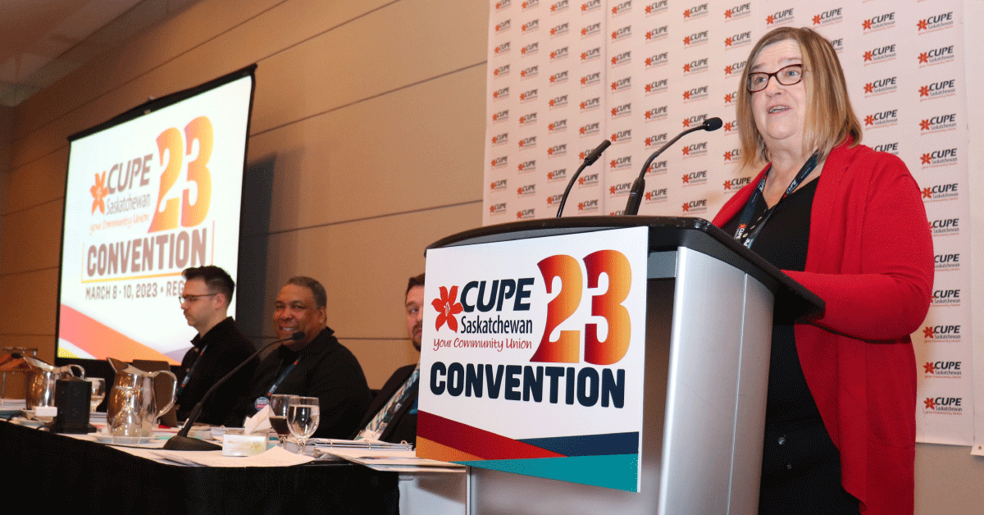
CUPE SASKETCHEWAN President Judy Henley

Slide 4
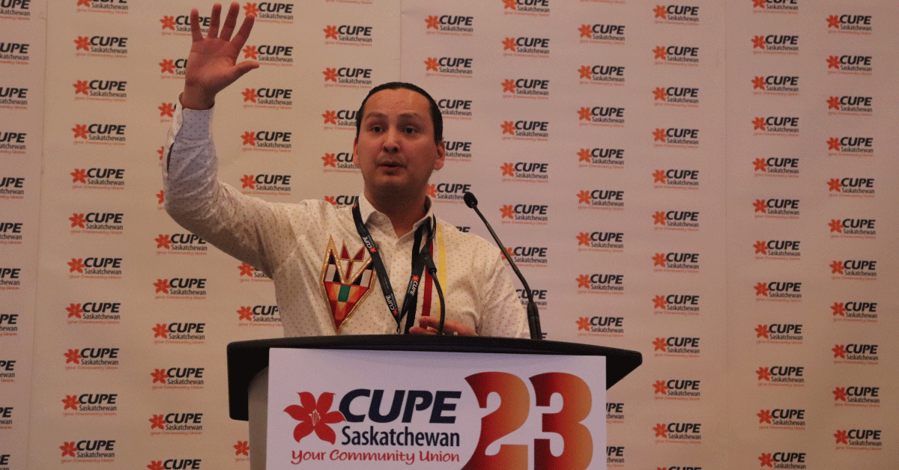
CUPE SASKETCHEWAN Chief Delorme
Cadmus Delorme, Chief of Cowessess First Nation, delivered an important message to delegates at the CUPE Saskatchewan convention on the need for everyone to act on Truth and Reconciliation and the 94 calls to action.
“We cannot even talk about reconciliation until we understand and accept the truth, and reconciliation can only happen with uncomfortable conversations,“

Slide 5
CUPE SASKETCHEWAN
Day one opened with a prayer from Elder Joyce Racette. The usual convention items were attended to before moving on to some amazing well spoken and passionate guests. Chief Delorme had the entire rooms attention and was likely the highlight of the day. There was a year in review and will soon be on the Cupe Sask website. Mark Hancock spoke and gave a very positive speech for the future of Cupe and all that it stands for and does.

Slide 6
CUPE SASKETCHEWAN
Day Two March 9th
Smudge with John Brady
Reconvene
Global Justice Video
National Treasurer Report
Greetings Cupe Manitoba
Sask Treasurer Report
Trustee Report
Budget 2023
Regional Rirectors Report
Guest Speakers and Elections

Slide 7
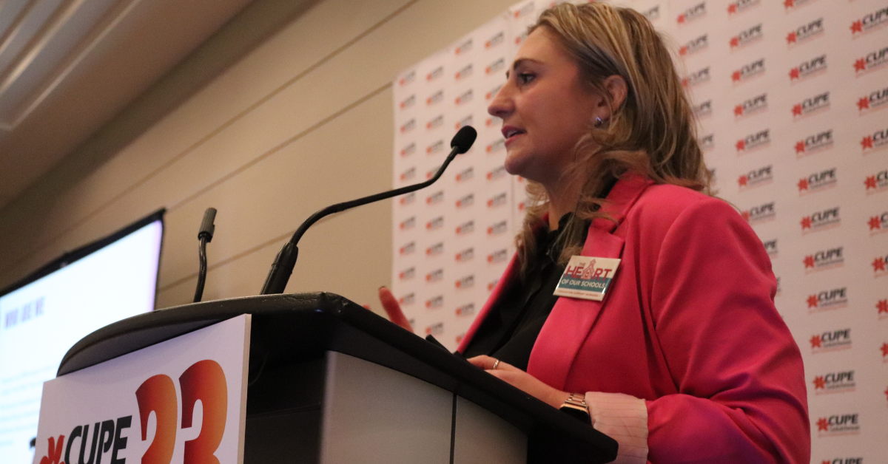
CUPE SASKETCHEWAN President OSCBU Laura Walton

Slide 8
CUPE SASKETCHEWAN
Day 2 started with breakfast with the nation president and treasurer. We started the day with a very informative video on global justice. We moved into the finials of the unions. Our regional director Ian Iwanchuck that said thigs are growing in the right direction. There was a great panel discussion on overcoming barriers to activism and political action. All 4 speakers Aubry Gonsalves, Emily Hitchings, John Brady, and Nathaniel Teed did a fantastic job. It was then elections and adjournment

Slide 9
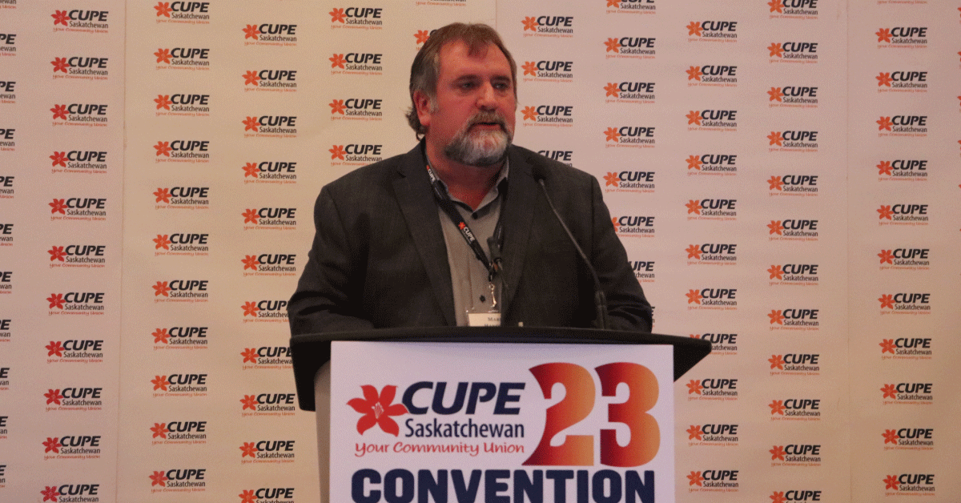
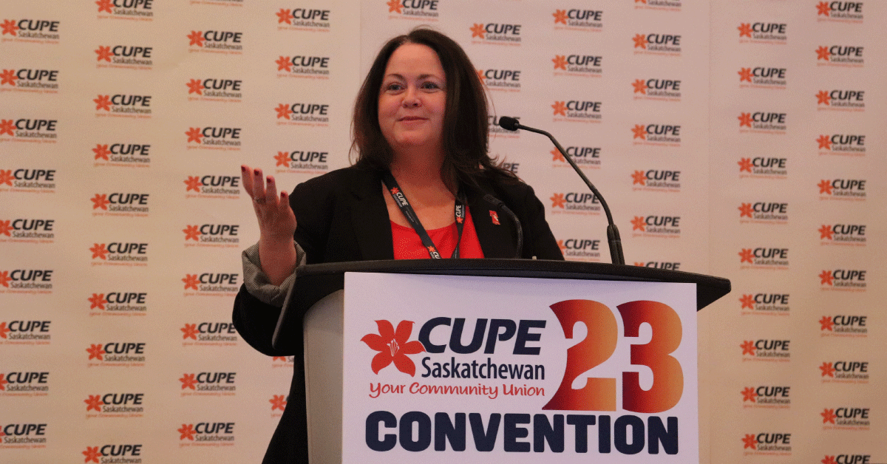
CUPE SASKETCHEWAN National president Mark Hancock
National Secretary Candice Rennick

Slide 10
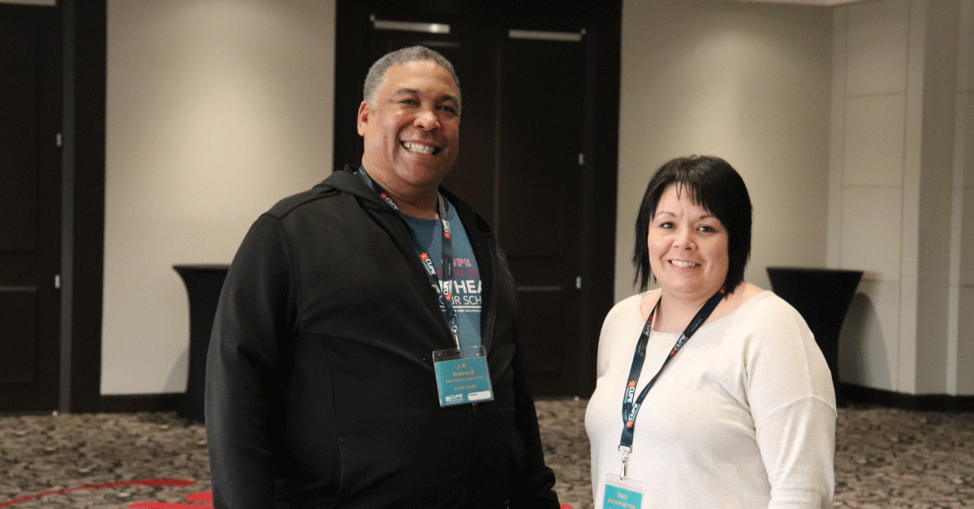
CUPE SASKETCHEWAN Congratulations
With CUPE Saskatchewan’s 2023 Convention underway, delegate Wayne Harriman was elected to a 3 year term as Trustee. Delegates elected J.R. Simpson as vice-president and Erin Auchstaetter recording secretary during elections held on Thursday, March 9, 2023.

Slide 11
CUPE SASKETCHEWAN
Day Three March 10th
Smudge with John Brady
Reconvene
Mental Health
NDP and Carla Beck
Proposed Affiliation with the NDP
Activism Award
Closing Remarks
Adjournment

Slide 12

CUPE SASKETCHEWAN Cupe Local 3364
“Just a few days ago, our group home was facing closure and the CUPE members who worked there were preparing to be laid off,” said Angie Pawliw, president of CUPE Local 3364. “Thanks to the support of our community and the solidarity of CUPE members from across the province, we’ve been notified by the employer of the great news that the home will remain open.”

Slide 13
CUPE SASKETCHEWAN
In conclusion it was great to meet in person for this years convention. The overall turn out was low but made it easier to express yourself at a microphone. The speakers were all fantastic and the reolutions and the way they are conducted needs some work. Wayne and myself thank the local for the opportunity to represent them and look forward to what our roles as union leaders will bring.

