Slide 1
RIGHTS & RESPONSIBILITIES IN THE TIME OF COVID-19

Slide 2
Questions During the Webinar
Q&A feature at the bottom of your screen.
If we can't get to your question, we will get back to you via email.

Slide 3
Prevention Through Education
Our goal is to provide the education and resources necessary to effectively participate in health and safety at the workplace to prevent injury, illness, disease and death.

Slide 4
Objectives
Discuss legal responsibilities of parties in the workplace.
Explain occupational health and safety rights.

Slide 5
OH&S Responsibilities
Under both provincial and federal legislation there are legal responsibilities.
Duties of Employers; SEA – Act, sections 3-8
Duties of Supervisors; SEA – Act, sections 3-9
Duties of Workers; SEA – Act., sections 3-10
WCB website – Information for Workers during COVID 19
Saskatchewan.ca – COVID 19 – Information for Workers
Canada Labour Code S. 124-5: Duties of Employers
Canada Labour Code S. 126: Duties of Employees

Slide 6
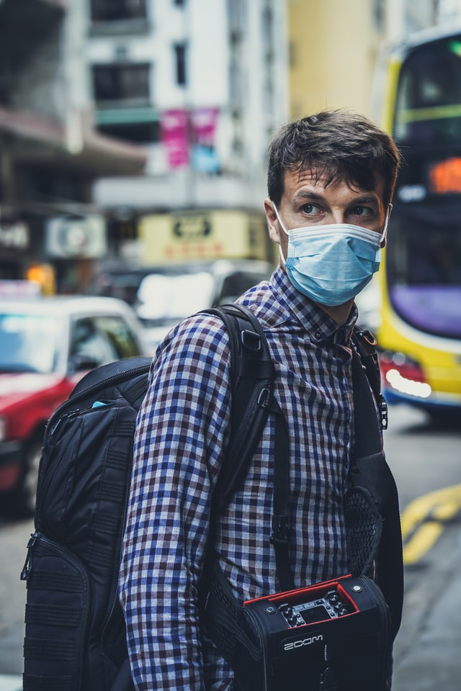
OH&S RIGHTS
What are our OH&S rights?
The Right to Know
The Right to Participate
Right to Refuse Unsafe Work
* Free from Discriminatory Action
Act – Section 3-35

Slide 7
WHAT HAS CHANGED?
Workplaces today are very different than they were before the pandemic
Some workers have been recognized as essential.
For some, this has meant an increased workload.
Some of us are now working from home (remotely).
Some workplaces have new restrictions and protections in place.
As a result, some of us are newly working alone.
Some of us are encountering new challenges in our interactions with other workplaces.
Meetings are taking place virtually.

Slide 8
NEW AUTHORITIES AND ORDERS
Provincial Medical Health Officer
Chief Medical Officer of Canada
Updated Public Health Orders

Slide 9
RESPONSIBILITIES
Employer
Worker
Supervisor
Exposure control plans
Engineering controls
PPE
Regulations still in force
Working alone
Ergonomics
Violence
Mental health
Staying home if sick
Following new procedures (PPE)
Utilize your OH&S rights
Ensure workers understand hazard posed by COVID-19
Apply employer’s health and safety program
It is a responsibility of all parties to follow the directions of the Provincial Medical Health Officer.

Slide 10
RIGHT TO KNOW
The right to know has not changed; workers must be informed of the hazards that are present, or likely to be present, in the workplace.
Employers cannot presume that all workers are fully informed on the hazard posed by the virus.
Different tasks present different levels of risk.
Privacy rights must be respected.

Slide 11
RIGHT TO PARTICIPATE
Joint Health and Safety Committees have not been suspended.
The committee is more important now than ever.
The responsibilities of the committee under legislation have not changed.This includes inspections and investigations.
Meetings can be conducted in multiple, contactless formats.
Exposure control plans must be developed in consultation with the committee.
You as a worker still have the same rights to participate.

Slide 12
RIGHT TO REFUSE
This fundamental right has not changed due to the COVID-19 pandemic.
The steps of a lawful refusal of unsafe work must be followed.
Each refusal will be determined on its merits.
Specific consideration for the individual worker will be made.
Controls in place, possibility of distancing, presence of the virus in community and other factors will be considered.

Slide 13
DISCRIMINATORY ACTIONS
Workers are not to be punished for exercising their rights at work, including following the orders of the Medical Health Officer. This includes:
suspension, layoff or dismissal;
demotion or loss of opportunity for promotion;
transfer of duties, change of location of workplace, reduction in wages or change in working hours;
coercion or intimidation;
imposition of any discipline, reprimand or other penalty;
the discontinuation or elimination of the job of the worker.

Slide 14
RECOVERY
This pandemic will end, and workplaces will begin to recover. The recovery will be gradual and the Joint Health and Safety Committee must be involved.
The Medical Health Officer will continue to issue orders and guidance for the recovery.
We must not forget what has been learned in response to this crisis.
Our workplaces may forever be changed by our understanding of this pandemic.

Slide 15
ADDITIONAL WEBINARS
OH&S Committee Role During COVID-19
Mental Health during COVID-19 - Building Psychologically Healthy Workplaces

Slide 16
FOLLOW UP HELP AND ADVICE
Q & A from Webinar sfl@sfl.sk.ca
Booking a webinar for your local d.Kapacila@sfl.sk.ca
Contact an oh&s officer at 1-800-567-7233

